Slide 1



KEYLOGGER ETHICAL HACKING PROJECT
Project By:
Sarbananda Taw
Siddharth Singh Slathia
Anhad Singh
Angad Pal Singh

Slide 2


INTRODUCTION KEYLOGGER
A keylogger is a surveillance tool designed to record every keystroke made on a device.
It can be used for monitoring, cybersecurity testing, or parental control.
Types: Software and Hardware
Use Cases: Monitoring user input, capturing sensitive data

Slide 3

PROJECT OBJECTIVES
Capture keystrokes silently
Automatically send logs to the cloud
Bundle with an application for stealthy installation
Run in the background with persistence

Slide 4

TOOLS & TECHNOLOGIES
Python (keyboard module)
Nultka (compiles Python into an executable)
Google Drive (for storing logs)
Socket/HTTP (for data transmission)
Windows OS

Slide 5
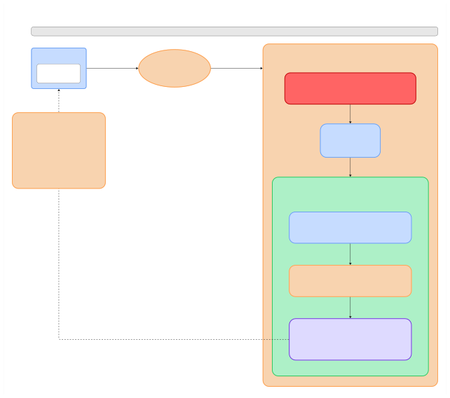

Network Packet Flow: Host PC
→
Keylogger Server (Port 8080)
Host PC
→
Internet
→
GCP Infrastructure Firewall
→
Keylogger Server
Host PC Client Application
Internet
Google Cloud Platform (GCP) - User Account Container
Initiates Connection: 34.x.x.x:8080 (External IP + Port)
TCP SYN to
Public Network
Route to GCP
34.x.x.x:8080
GCP Infrastructure Firewall Firewall Rule: Allow TCP Port from Any Source (0.0.0.0/0) Target: External IP 34.x.x.x → Internal IP 10.x.x.x (NAT Translation)
Firewall check
Packet Details Source: Host PC (Dynamic IP) Destination: 34.x.x.x:8080 Protocol: TCP Purpose: Keylogger Data Transfer Firewall Requirements 1. GCP Firewall: Allow TCP:8080 2. VM Firewall: Allow TCP:8080 3. Server Process: Bind to 0.0.0.0:8080
GCP NAT Translation 34.x.x.x:8080
↓
10.x.x.x:8080
NAT Translation
Virtual Machine Instance (Linux Server) VM only knows internal IP: 10.x.x.x (External IP invisible to VM)
SYSTEM ARCHITECTURE
VM Network Interface (what VM sees) eth0: 10.x.x.x/24 (VM only knows internal IP) External IP: 34.x.x.x is managed by GCP, invisible to VM
VM Firewall check
VM Internal Firewall (iptables/ufw) Rule: ALLOW incoming TCP connections on port 8080 Interface: Listen on all interfaces (0.0.0.0:8080)
Server Accepts
Keylogger Server Application Process: Node.js/Python Server listening on 10.x.x.x:8080 Function: Captures and logs keystrokes for academic research Status: LISTENING and ready to accept connections Bind Address: 0.0.0.0:8080 (accepts from any interface)
Response Flow: Server ACK back to Host PC
(reverse NAT: 10.x.x.x → 34.x.x.x)

Slide 6
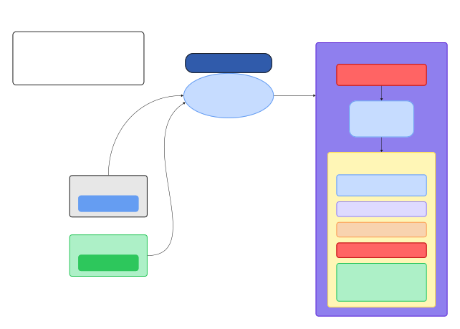
GCP Remote Desktop Access Architecture
Connection Flow
1.Client initiates RDP connection to External IP
2.GCP Firewall allows port 3389 traﬃc
3.Traﬃc routed to VM's Internal IP
4.XRDP serves desktop session to client
Google Cloud Platform
RDP Protocol Remote Desktop Protocol
GCP Firewall Port 3389 (RDP) Open
Firewall check
Internet Public Network
Port 3389
RDP Request
RDP Request
GCP NAT Translation 34.x.x.x:8080
↓
10.x.x.x:8080
to 34.x.x.x
to 34.x.x.x
SYSTEM ARCHITECTURE
NAT Translation
VM Instance (Linux)
Host PC Windows/Mac/Linux
External IP: 34.x.x.x (Public) Internal IP: 10.x.x.x (Private)
Remote Desktop Client
XFCE Desktop Environment
XRDP Server (Port 3389)
Additional User PC (No Google Account)
VM Firewall (Local)
Remote Desktop Client
User Accounts 1. Google Account User 2. Additional Local Users (No Google credentials needed)

Slide 7

HOW IT WORKS
1. User opens an application (with the keylogger bundled)
2. The keylogger starts silently in the background
3. Keystrokes are logged and stored locally
4. Logs are uploaded to Google Drive for remote access
5. Program runs automatically on every boot (via startup configuration)

Slide 8
STEALTH & PERSISTENCE
Compiled using Nuitka – source code is hidden
Runs as a background process with no console window
Configured to launch automatically on system startup
Minimizes antivirus detection through executable packaging

Slide 9

Use only for authorized security testing purposes
Keyloggers are illegal without informed user consent
Follows ethical cybersecurity research guidelines
Aims to help understand attacker techniques and improve defenses
ETHICAL CONSIDERATIONS

Slide 10

CHALLENGES FACED
• Avoiding antivirus detection
• Packaging everything into a clean and stealthy executable
• Ensuring reliable log uploading to the cloud
Solutions:
Used Nuitka, file cleanup methods, and Google API automation

